Slide 1

TRAFFIC BASED SIGNAL CONTROLLING

Slide 2

INDEX
INTRODUCTION TO CONCEPT
OBJECTIVE
LITERATURE REVIEW
COMPONENTS AND TOOLS
PROCESS FLOW CHART
CIRCUIT DIAGRAM
LOGIC
RESULT
LIMITATIONS
FUTURE SCOPE

Slide 3
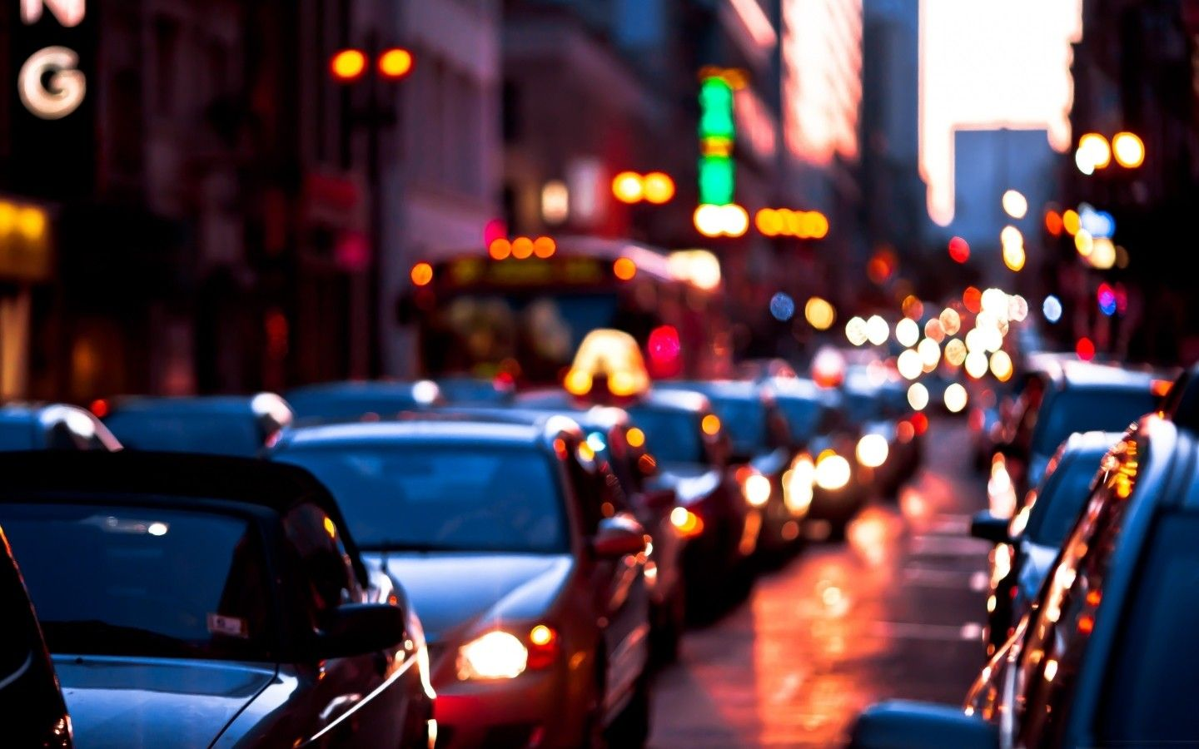
INTRODUCTION TO CONCEPT
Increasing on road traffic and primitive traffic management systems lift up the need of introducing new traffic system which is efficient enough to deal with varying traffic density approaching the intersection and to reduce traffic congestion.
To solve this issue we introduce a new system which can be installed in the existing traffic signal controlling systems such that it fulfils the requirements of current traffic situations.
The system includes feature to control varying traffic density and hence reduces the traffic congestion and pollution.

Slide 4
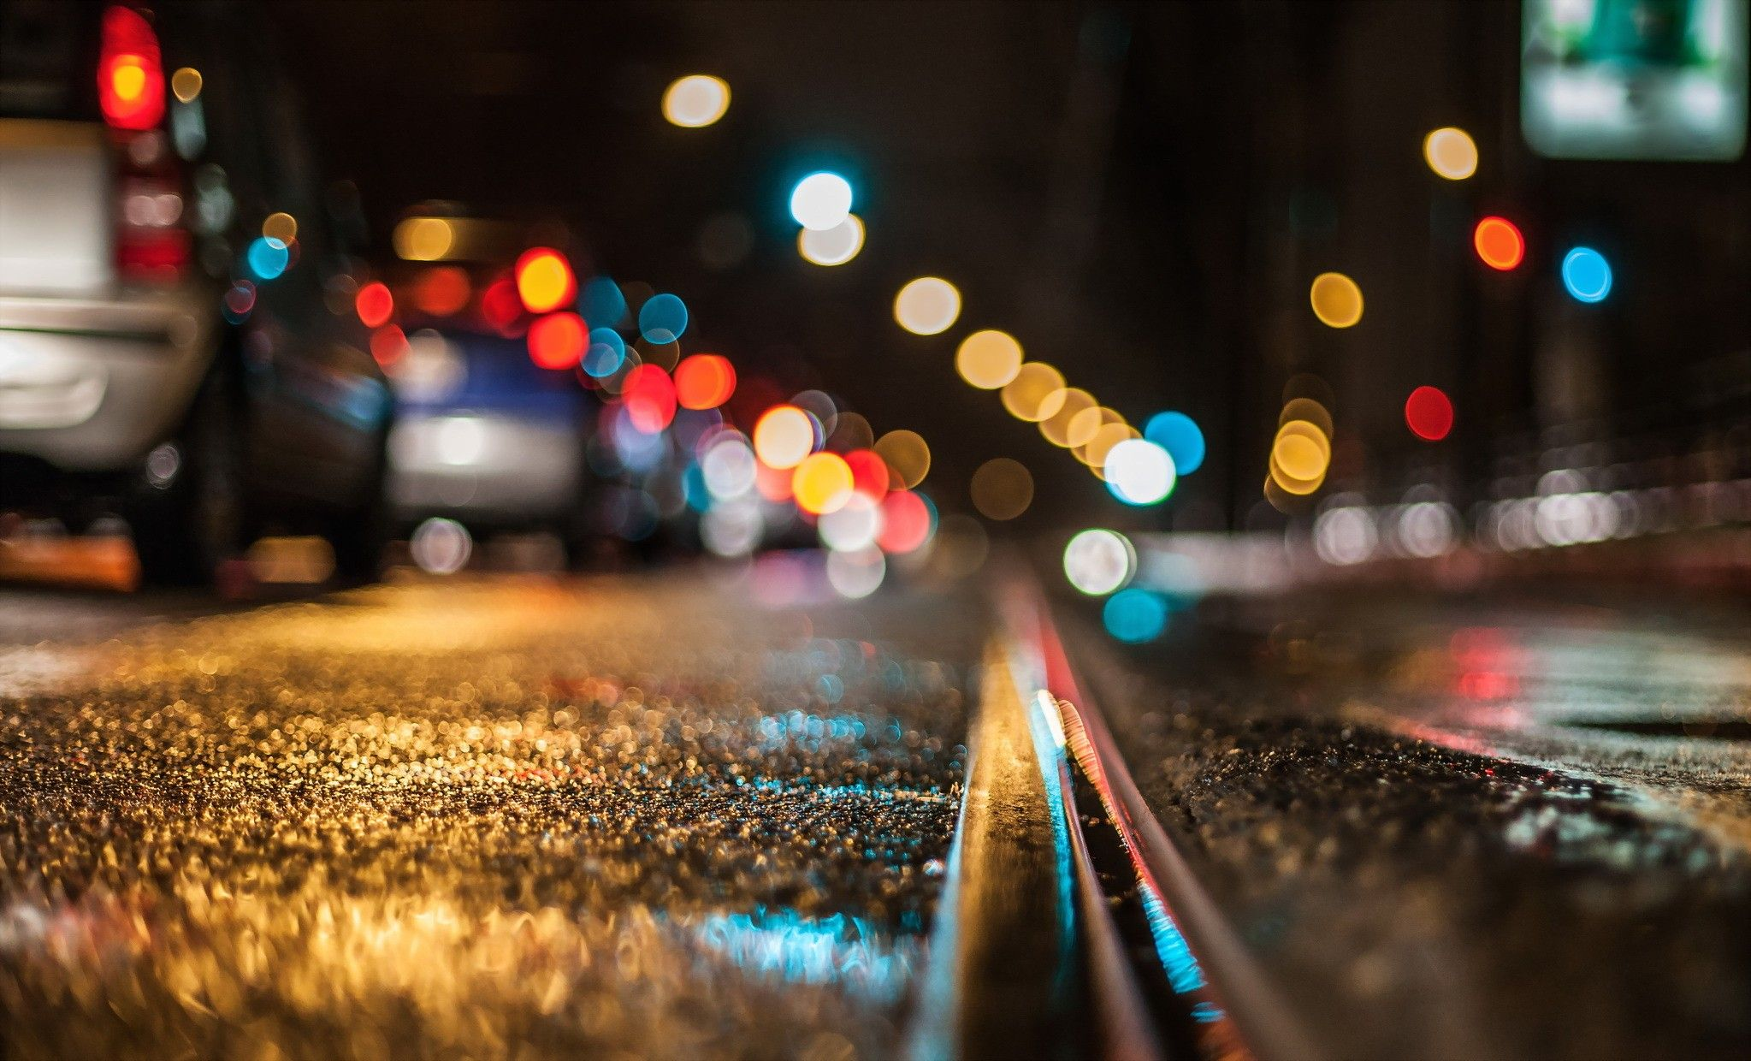
OBJECTIVE
The proposed model focuses on building a small system that can be installed in the existing signal mechanism in order to alter its characteristic of pretimed signals to a systematic time variation technique.

Slide 5
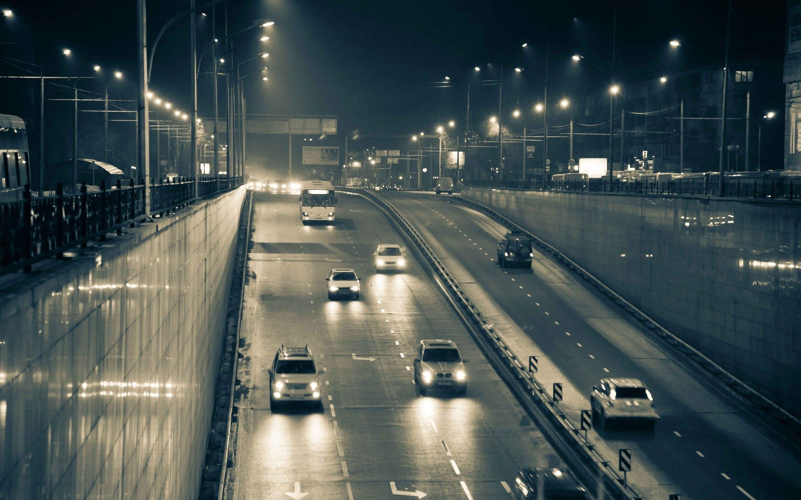
LITERATURE REVIEW
Sr. No. | NAME OF ARTICLE | ADVANTAGES | DISADVANTAGES | FUTURE SCOPE
1. | A Simulation Study for Improving the Traffic Flow Efficiency of an Intersection Coupled with BRT.(2020) | Based on the simulation studies on signal design, it is identified that in order to reduce the delay at the intersection different phase system of signals are designed | Adopting a 2-phase system in the field is quite risky because of conflicts generated from the right turners and straight moving vehicles from the opposite direction. | The study can be extended by designing the vehicular actuated signal system for BRT and assessing its impact on overall delays of the system
2. | Traffic Signal Management using Machine Learning Algorithm (06-June-2020) | The system enables to distribute the traffic congestion evenly throughout the area. 2. Controls the traffic flags powerfully dependent on the present traffic density and considering the memorable traffic density esteems | Practical implementation possible at minimum extent. Data handling failure due to continuous update of data with new traffic congestion type. | To contrast the reproduced qualities and the constant qualities got from the API. Quantify the distinction between these qualities, and establishing complete technological dependency.
3. | Traffic signal control for smart cities using reinforcement learning.(15 March 2020) | Maximize the number of vehicles crossing an intersection and balance the signals between roads. | Practical implementation at only some of the places. Solution restricted to sophisticated traffic congestions | The proposed system has a flexible structure that can be modified to suit the changes in future generations.
4. | Improving Road Traffic Forecasting Using Air Pollution and Atmospheric Data: Experiments Based on LSTM Recurrent Neural Networks. (30 June 2020) | Strategized use of atmospheric pollution and concentration of pollutant to estimate the traffic congestion and traffic density at the place. | No majors taken to reduce atmospheric pollution. Short termed data storage | Introducing a system to concentrate pollutants at a place and derive data from analyzing amount of pollutants concentrated.

Slide 6
LITERATURE REVIEW
Sr. No. | NAME OF ARTICLE | ADVANTAGES | DISADVANTAGES | FUTURE SCOPE
5. | Arduino Based traffic congestion control with automatic signal clearance for emergency vehicles and Stolen Vehicle Detection (01 June 2020 ) | No vehicle is capable of violating the traffic law. Traffic police work is reduced to maximum extent. | Frequent and periodic maintenance is required Time delay takes place during opening and closing of gates. | Separate ambulance channel formation with traffic by pass mechanism. Forming more faster process to alter the rate of movements of barrier gates
6. | Smart Traffic Management System for Traffic Control using Automated Mechanical and Electronic Devices.(2018) | Routing traffic to reduce travel time during traffic hours. Fair load balancing over all of the routes. Separate emergency channels and routes. | Higher maintenance cost and restricted implementation. Need specific systems(chips )to be installed in all vehicles, hence cannot implemented against existing traffic. | Using routing traffic principle instead of signal mechanism to avoid traffic congestion
7. | Short-term traffic prediction model for urban transportation using structure pattern and regression: an Indian context (2020) | Predicting short term traffic flow using structure pattern and regression. Short term flow is considered hence no data congestion and data loss will take place. | Costs very higher with respect to restructuring the traffic management system.(Rs. 234,000 crores) Restricted to limited urban zones. | 1. This work can be extended by considering the other important external factors like climatic conditions, road diversions due to construction or road damage and traffic incidents.
8. | Evaluation of traffic management strategies for special events using probe data. (September 2019) | Strategy to manage traffic on public events and gathering. Continuous data analysis to route the traffic for efficient flow. Signal retiming for the event days. | Specifically require Bluetooth enabled devices. Insecurity of travel data. Only signal retiming made efficient flow. | The use of other traffic performance measures such as flows, density and level of service Big Data and Data Security.

Slide 7
LITERATURE REVIEW
Sr. No. | NAME OF ARTICLE | ADVANTAGES | DISADVANTAGES | FUTURE SCOPE
9. | Implementation and Evaluation of a Traffic Light Assistance System Based on V2I Communication in a Simulation Framework (2018) | Information about congestion provided continuously during travel. Optimal speed regulation of vehicles during travel. Efficient in reducing accidents. | Implementation restricted to urban areas only. Costlier project to be implemented and maintained. | The development of a new scenario with traffic lights and attached RSU in order to directly communicate with vehicles will follow in future work.
10. | A UAV Traffic Management System for India: Requirement and Preliminary Analysis. (07 November 2020) | Use of UAV’s for traffic surveillance, instead of traffic police. Complete automated based system controlling | 1. This increased UAV usage will cause an ecstatic burden on the airspace resulting in collisions and interference, possibly damaging property and endangering human lives. | More secured use of airspace. Specific movement channels for specific drones surveillance.

Slide 8
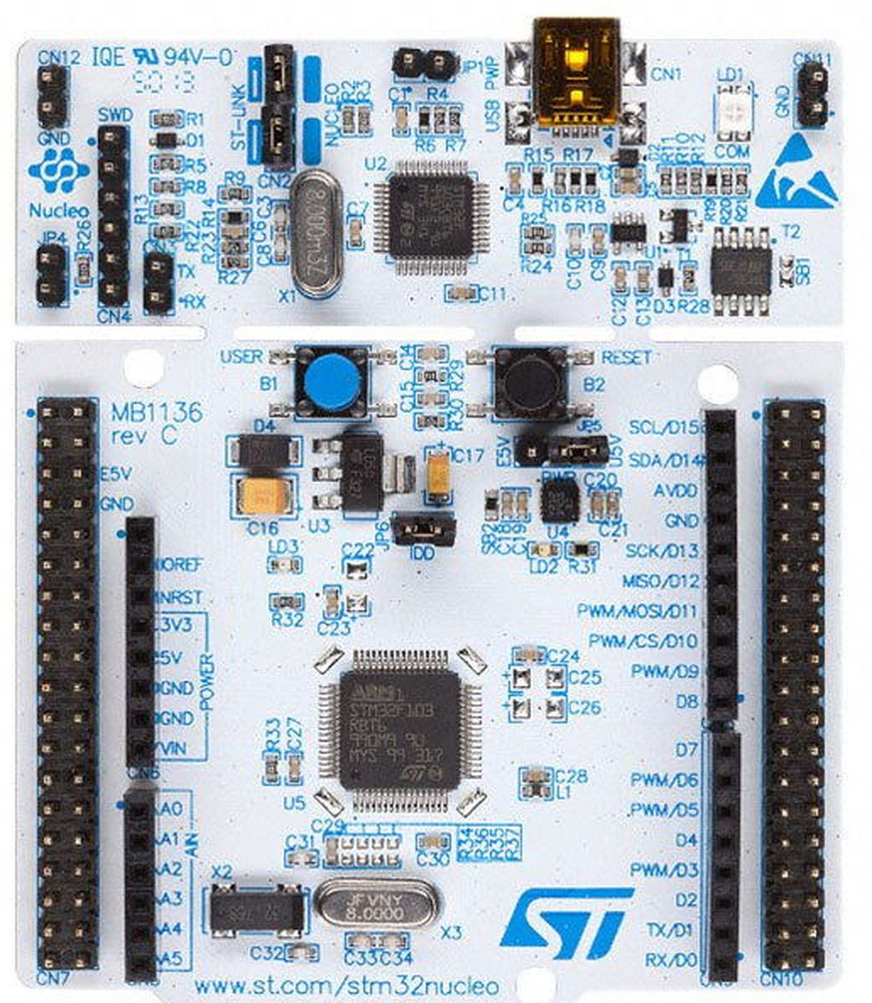
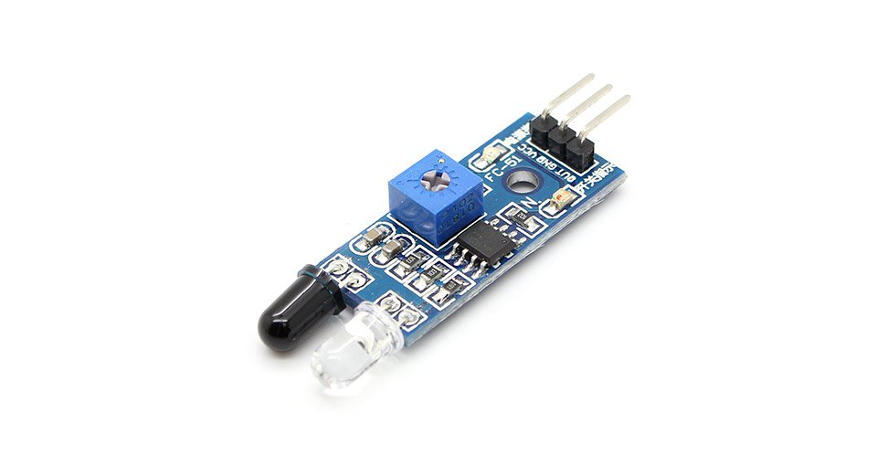
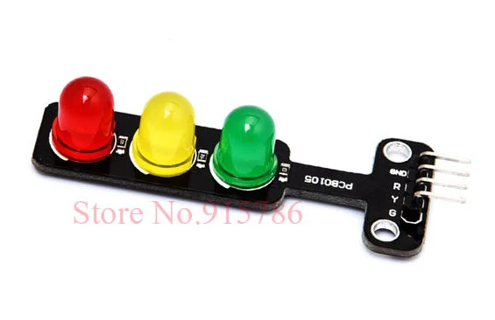
COMPONENTS AND TOOLS
IR SENSOR
TRAFFIC SIGNAL
NUCLEO STM32F446-RE DEVELOPMENT BOARD
TRANSMITTER
RECEIVER
POTENTIOMETER
INTEGRATED CIRCUIT
3 PINS
.VCC – POWER SUPPLY
.GND – GROUND PIN
.OUT- OUTPUT PIN WITH OUTPUT OF 1 AND 0
ARM CORTEX-M4 CORE AT 180MHz
32 BIT MICROCONTROLLER
64 PORT PINS
512KB OF FLASH MEMORY AND 128KB SRAM
CONNECTION THROUGH USB TYPE-A TO MINI-B CABLE
DEVELOPMENT TOOLS:
STM32CubeIDE
STM32CubeMX
IT HAS 3 LED’S OF COLOUR RED GREEN AND YELLOW EACH OF WHICH HAS A SINGLE PIN TO CONNECT IT WITH DEVELOPPMENT BOARD AND A GROUND PIN

Slide 9
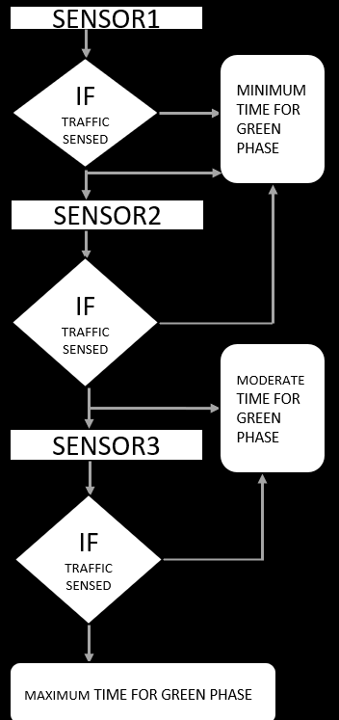
PROCESS FLOWCHART
SENSOR1
ROAD1
ROAD2
ROAD3
ROAD4
IF TRAFFIC SENSED
MINIMUM TIME FOR GREEN PHASE
SENSOR2
IF TRAFFIC SENSED
MODERATE TIME FOR GREEN PHASE
SENSOR3
IF TRAFFIC SENSED
MAXIMUM TIME FOR GREEN PHASE

Slide 10

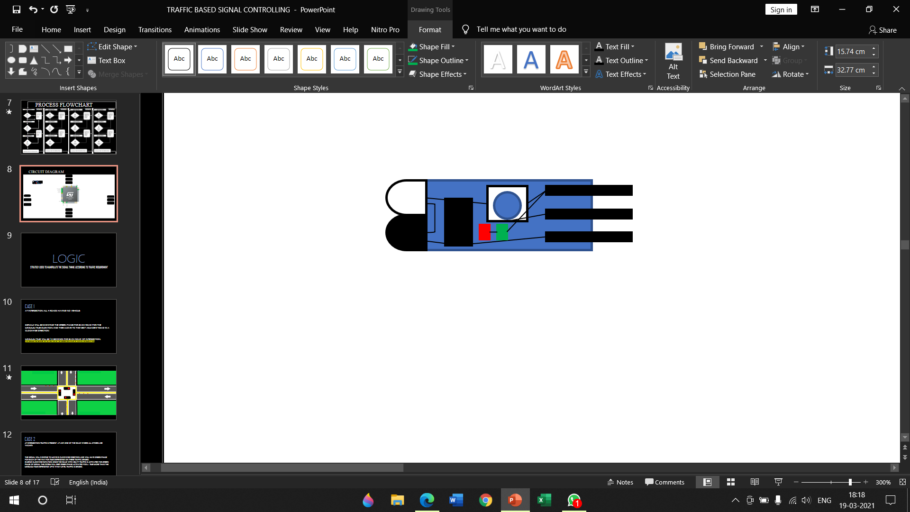
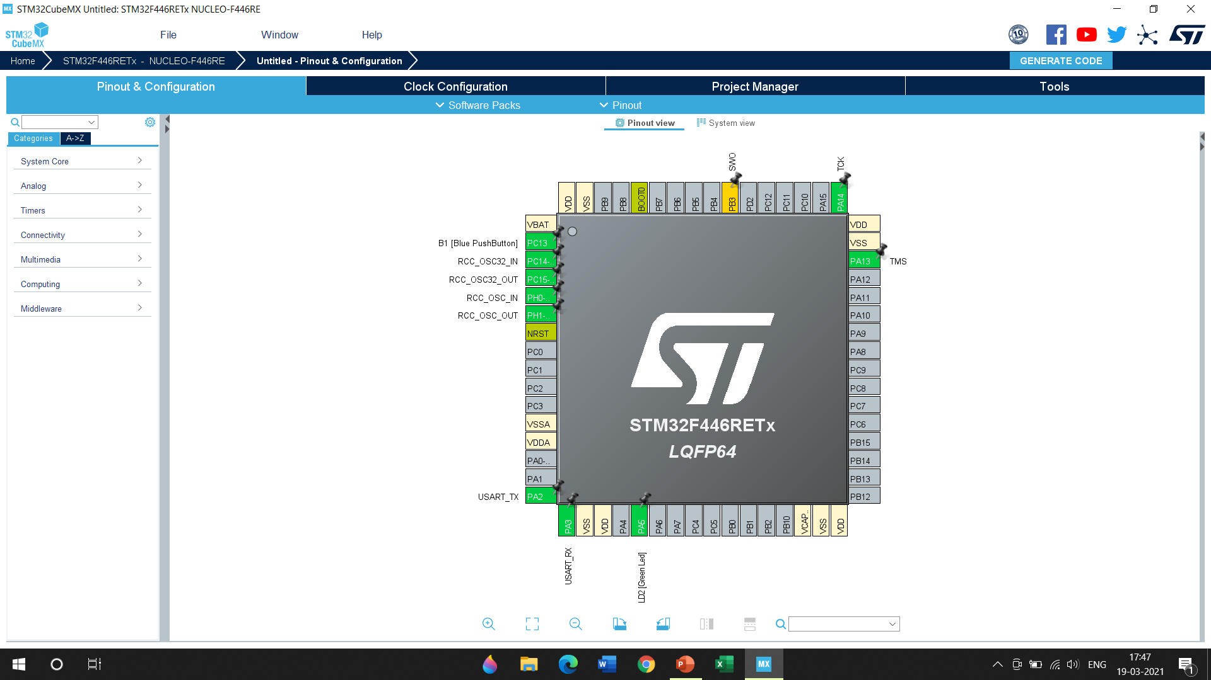
CIRCUIT DIAGRAM

Slide 11
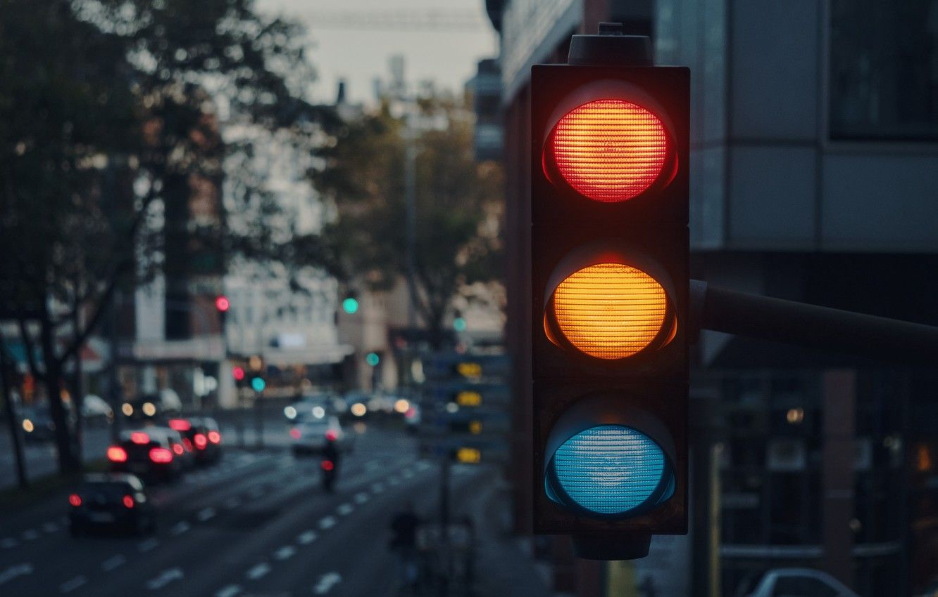
LOGIC
STRATEGY USED TO MANIPULATE THE SIGNAL TIMING ACCORDING TO TRAFFIC REQUIREMENT

Slide 12
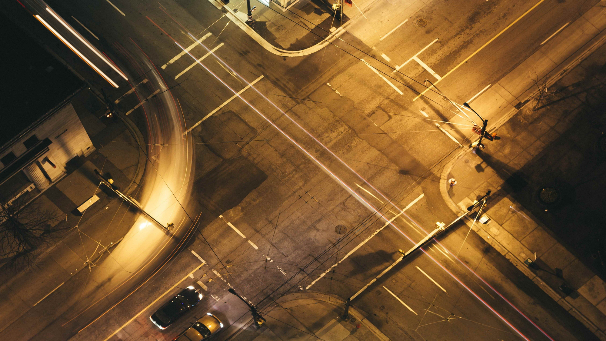
CASE 1
AT INTERSECTION ALL 4 ROADS HAVING NO VEHICLE:
SIGNALS WILL BE SHOWING THE GREEN PHASE FOR EACH ROAD FOR THE MINIMUM TIME DURATION AND THEN MOVE TO THE NEXT ADJACENT ROAD IN A CLOCKWISE DIRECTION
MINIMUM TIME WILL BE 10 SECONDS FOR EACH ROAD OF INTERSECTION.
(THE MINIMUM TIME DEPENDS ON THE LOCATION OF THE INTERSECTION IN CASE OF PRACTICAL IMPLEMENTATION)

Slide 13
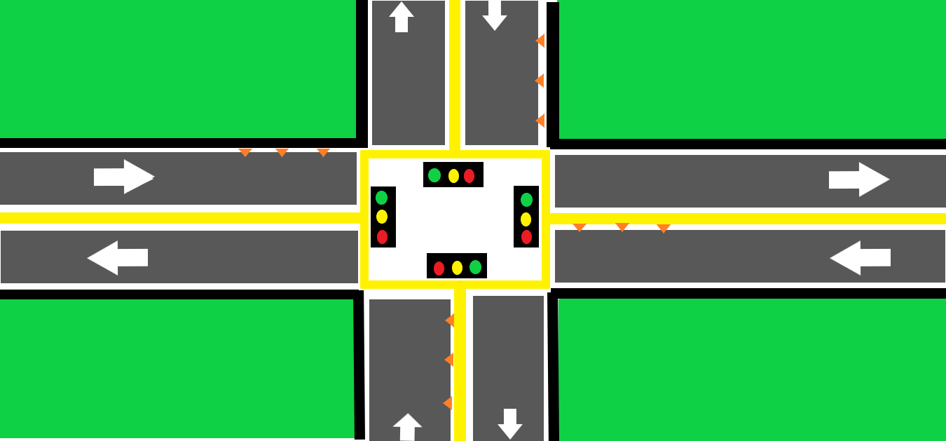
1
2
3
4
5
6
7
8
9
10
10
9
8
7
6
5
4
3
2
1
10
9
8
7
6
5
4
3
2
1
10
9
8
7
6
5
4
3
2
1

Slide 14

CASE 2
AT INTERSECTION TRAFFIC IS PRESENT AT ANY ONE OF THE ROAD WHERE ALL OTHERS ARE VACANT:
THE SIGNAL WILL CONTINE TO MOVE IN CLOCKWISE DIRECTION AND WILL HAVE GREEN PHASE FOR EACH OF THE WAY FOR TIME DEPENDING ON THERE TRAFFIC SENSED.
DURING CLOCKWISE ROTATION ONCE THE ROAD WITH HEAVY TRAFFIC IS ACTIVATED FOR GREEN PHASE OF SIGNAL THE SYSTEM WILL KEEP GREEN PHASE ACTIVATED FOR A TIME MORE THAN THE MINIMUM TIME DEPENDING UPTO WHAT LEVEL TRAFFIC IS SENSED.
THE GREEN PHASE FOR THE WAY WITH TRAFFIC IS ACTIVE FOR A CERTAIN TIME WHICH CAN BE EXPLAINED FURTHER

Slide 15
30
27
24
21
18
15
12
9
6
3
7
5
4
3
2
1
10
6
9
8
2 SENSORS DETECTED VEHICLE, HENCE WILL SEND MESSAGE TO PROCESSOR SUCH THAT THE TIME FOR GREEN SIGNALE FOR THIS WAY IS INCREAMENTED
MORE DENSE TRAFFIC AS COMPARED TO OTHERS HENCE THE GREEN SIGNAL WILL BE ACTINVE FOR LONGER TIME I.E 30 SECONDS
NO TRAFFIC IS BEING SENSED ,THE GREEN SIGNAL WILL BE ACTIVE FOR MINMUM TIME I.E. 10 SECONDS
NO TRAFFIC IS BEING SENSED HENCE GREEN SIGNAL WILL BE ACTIVE FOR MINIMUM TIME I.E. 10 SECONDS
1
2
3
4
5
6
7
8
9
10
10
9
8
7
6
5
4
3
2
1

Slide 16
CASE 3
TWO ROADS HAVING TRAFFIC :
THE SIGNAL WILL CONTINUE TO MOVE IN THE SAME CLOCKWISE DIRECTION WITH MINIMUM TIME FOR GREEN PHASE FOR ROADS WITH NO TRAFFIC AND FOR A VARYING TIME ON THE ROADS WITH TRAFFIC.
THE TIME FOR ROAD WITH MODERATE TRAFFIC WILL BE INTERMEDIATE OF MAXIMUM AND MINIMUM.
WHEREAS FOR THE ROAD WITH HEAVY TRAFFIC THE TIME WILL BE MAXIMUM FOR GREEN PHASE AND WILL LET THE TRAFFIC AT THAT SIDE MOVE FOR LONGER TIME.
FOR A GENERAL CASE
WE HAVE CONSIDERED MODERATE TRAFFIC WITH A GREEN PHASE OF 30 SECONDS.
WE ALSO HAVE CONSIDERED GREEN PHASE OF ROAD HAVINNG MAXIMUM TRAFFIC AS 60 SECONDS.
(THE MAXIMUM TIME DEPENDS ON THE LOCATION OF THE INTERSECTION IN CASE OF PRACTICAL IMPLEMENTATION)

Slide 17
20
30
40
50
60
10
1
9
8
7
6
5
10
4
3
2
HIGHLY DENSE TRAFFIC HENCE TIMME LIMIT FOR GREEN SIGNAL WILL BE EXTENDED TO MAXIMUM I.E. 60 SECONDS
ALL SENSORS SENSED TRAFFIC INDICATING THAT TRAFFIC HAS INCREASED TO MAXIMUM LEVEL HENCE INCHANGE THE TIME LIMIT TO MAXIMIM
NO TRAFFIC IS SENSED HENCE THE SIGNAL WILL BE GREEN FOR MINIMUM TIME I.E. 10 SECONDS
MODERATE TRAFFIC IS SENSED HENCE THE TIME LIMIT WILL BE INCREAMENTED FROM MINIMUM TIME I.E 10 SECONDS TO 30 SECONDS
NO TRAFFIC IS SENSED HENCE THE SIGNAL WILL BE GREEN FOR MINIMUM TIME I.E. 10 SECONDS
2 SENSORS SENSED THE TRAFFIC INDICATING THAT TRAFFIC HAS RAISED TO MODERATE LEVEL AND HENCE TO INCREASE THE TIME LIMIT FOR GREEN SIGNAL
1
2
3
4
5
6
7
8
9
10
18
15
9
6
30
27
24
21
12
3

Slide 18
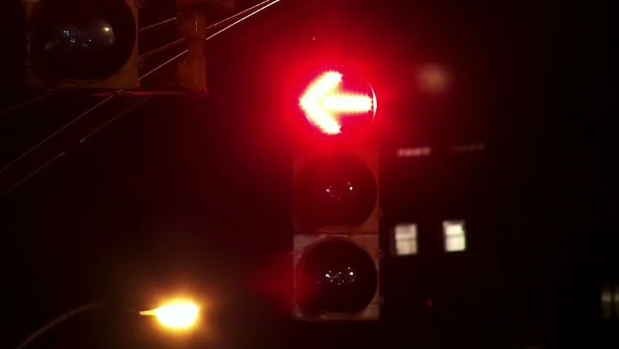
RESULTS
USING THE GIVEN SYSTEM/PROTOTYPE THE TRAFFIC CONGESTION IS REDUCED TO SOME EXTENT.
SINCE VEHICLES ARE WAITING AT SIGNAL FOR LESS TIME THE POLLUTION IS REDUCED TO A MINOR EXTENT.
A COMPITABLE PROTOTYPE OF SIGNAL MANGEMENT IS FORMED WHICH CAN SUSTAIN NEXT 3-5 DEVELOPING YEARS OF THE COUNTRY, SPECIFICALLY INDIA

Slide 19
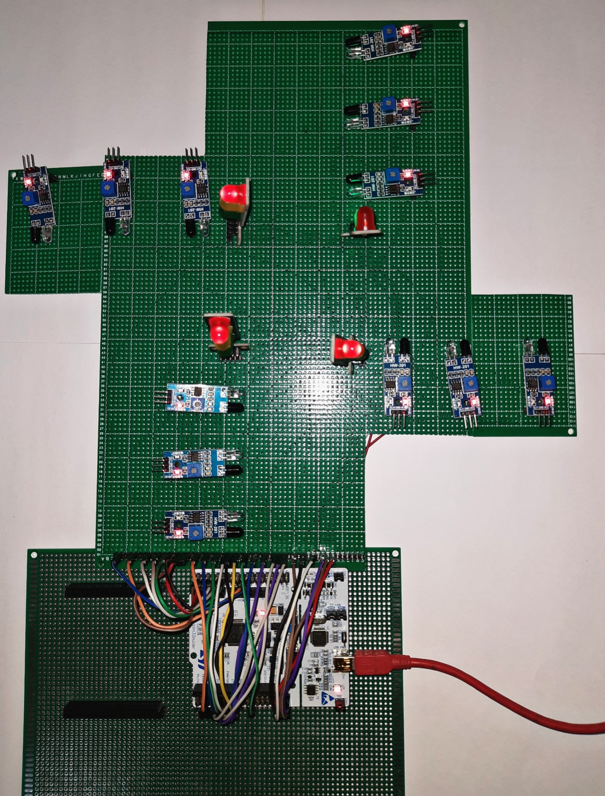

Slide 20
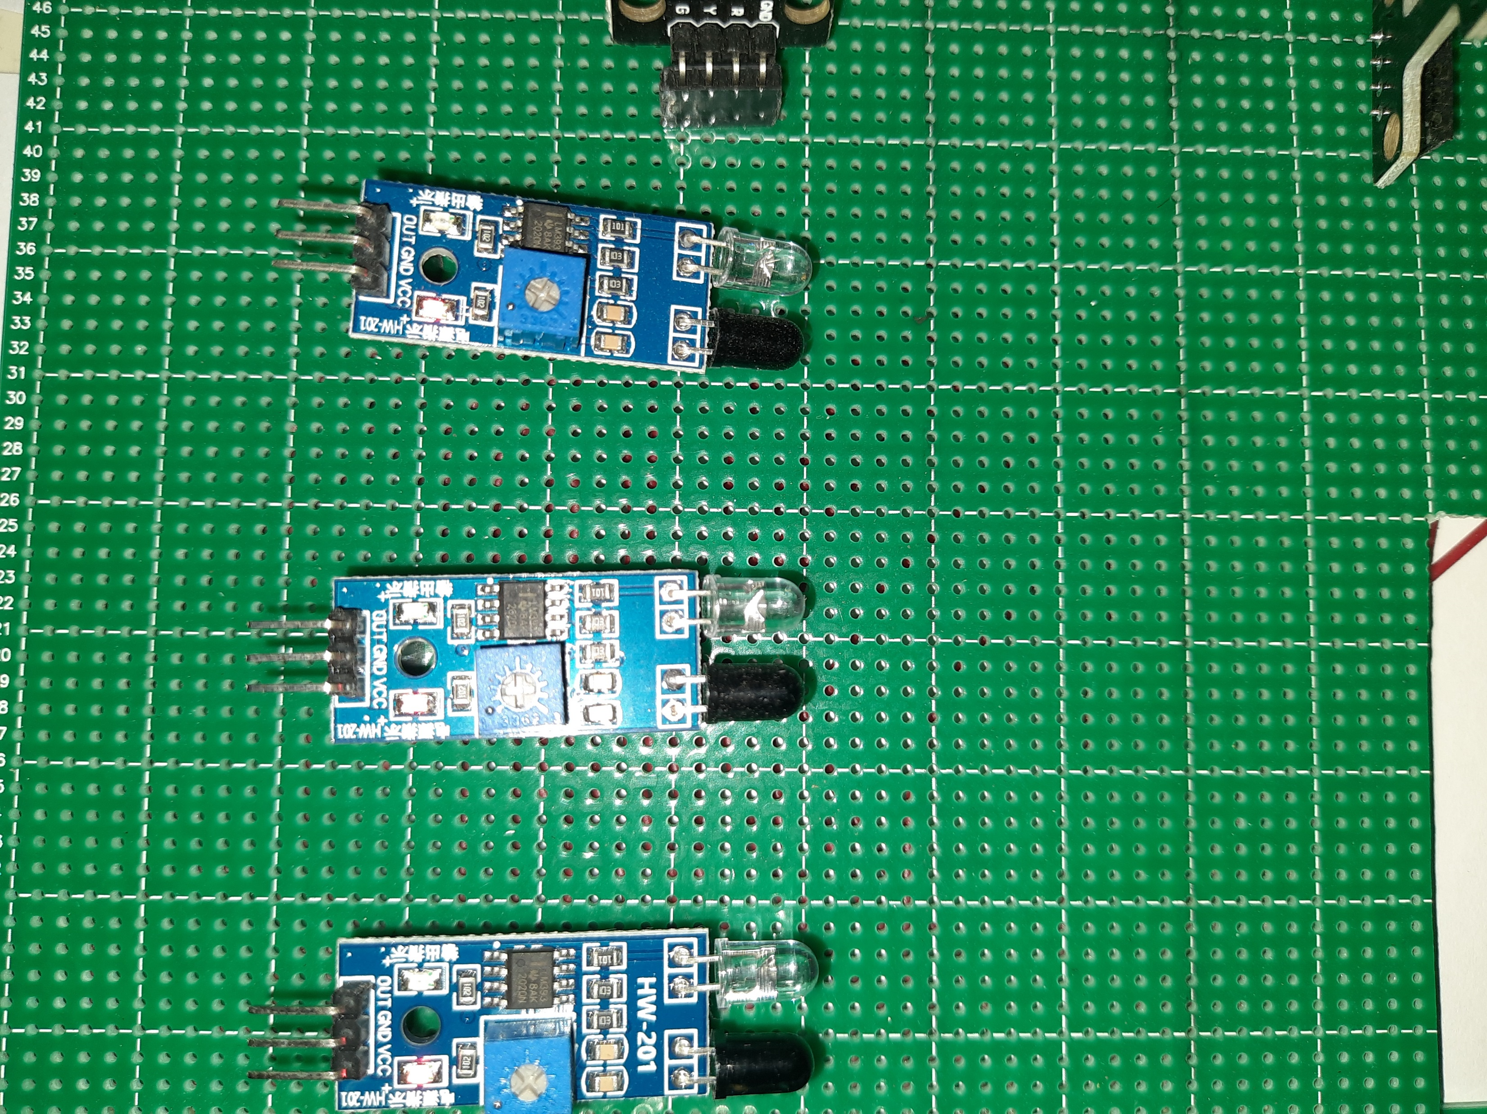
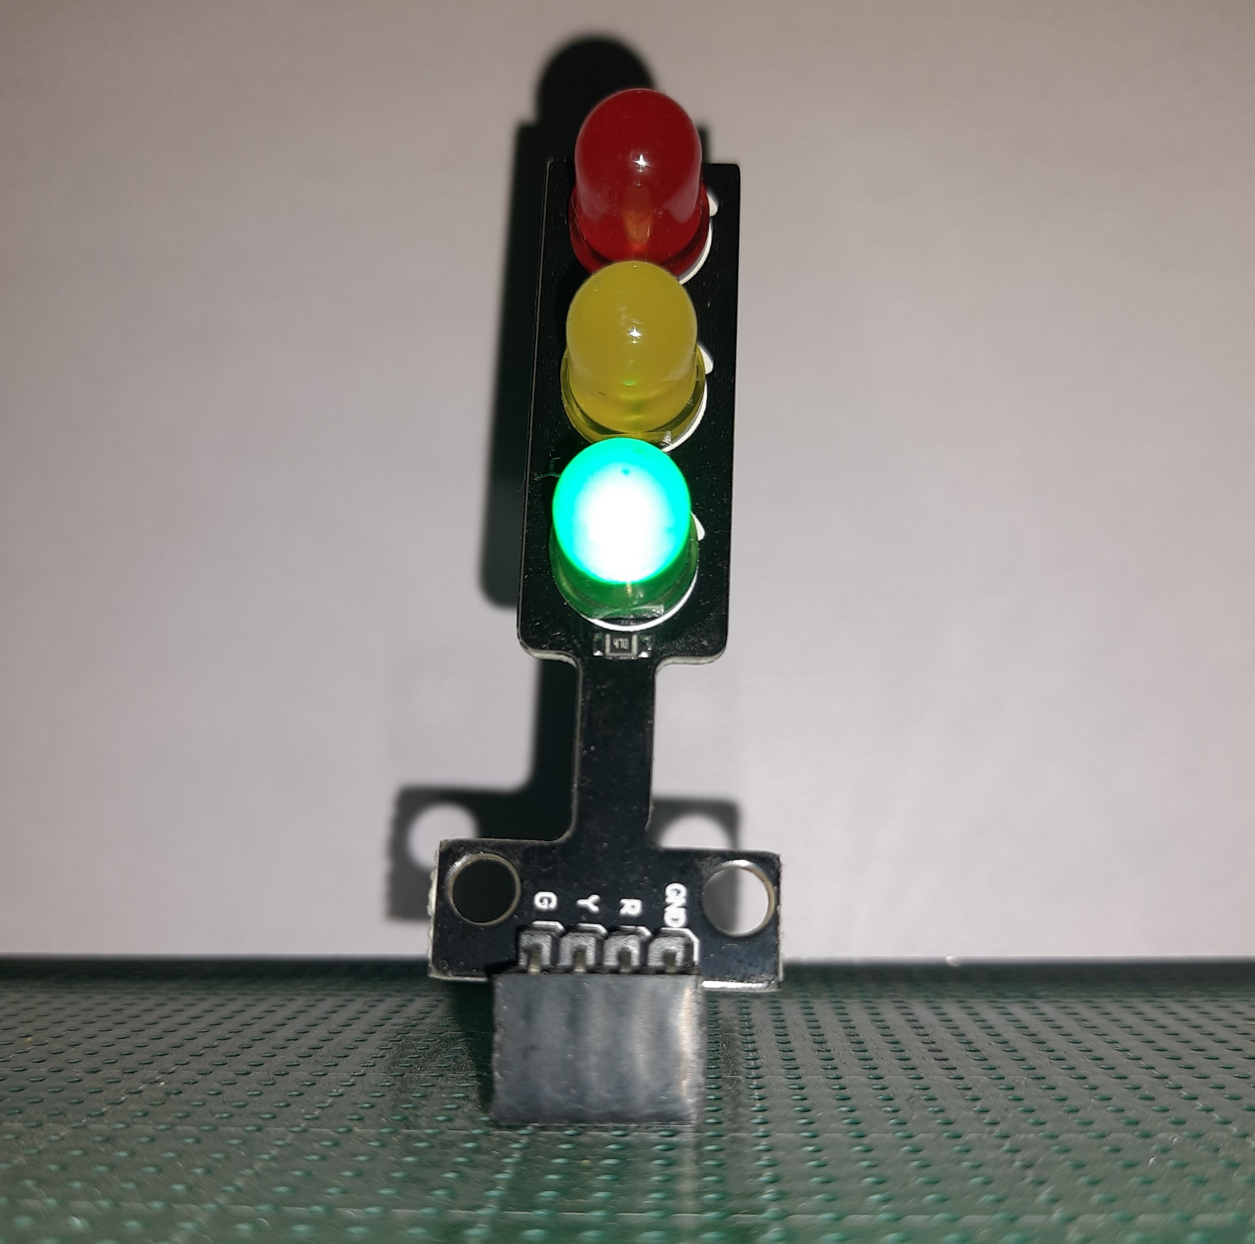
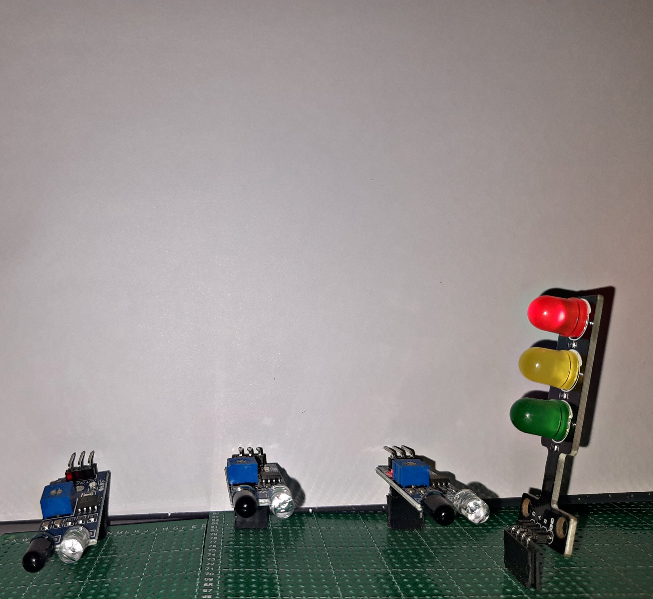
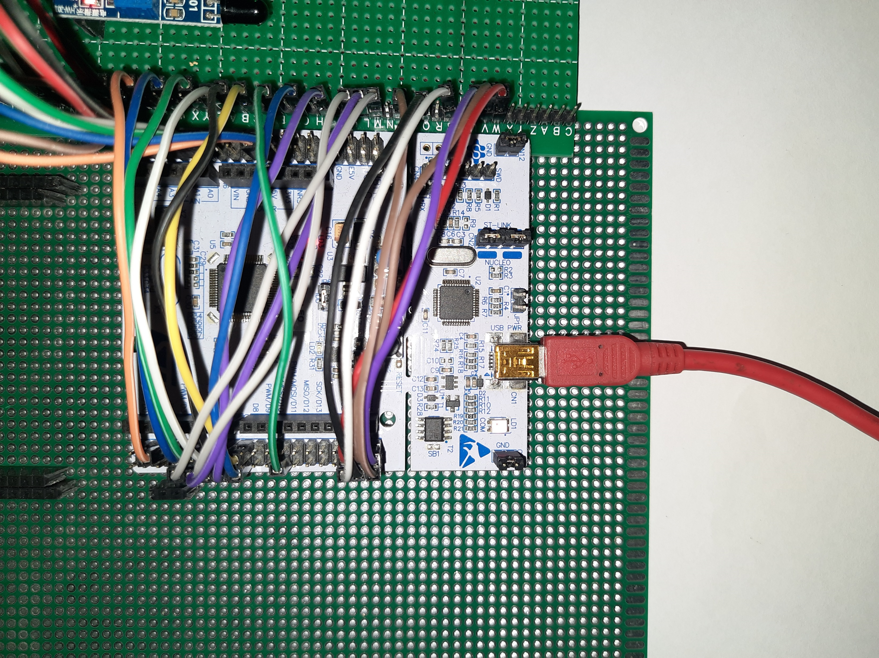

Slide 21
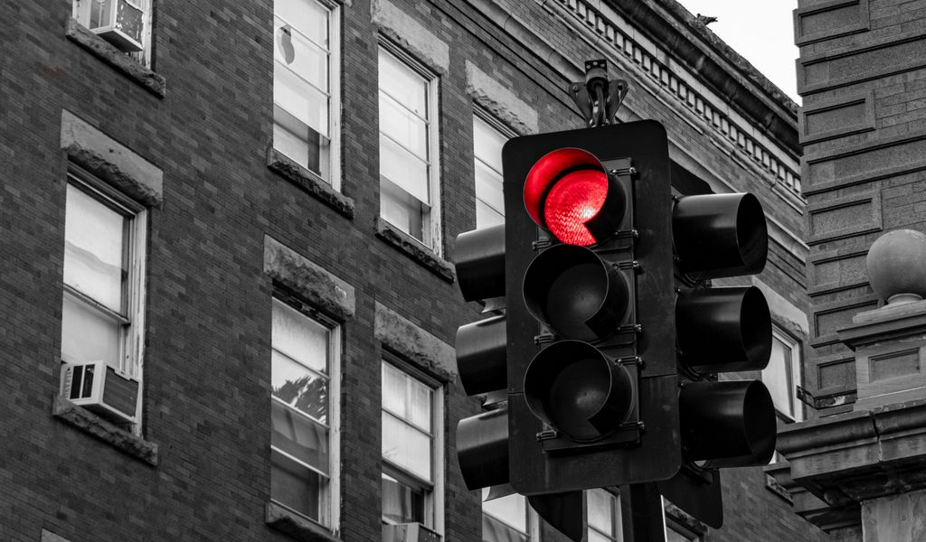
LIMITATIONS
CANNOT WITHSTAND COMPLEX TRAFFIC CONDITION.
POWER DEPENDENT ON A SOURCE.
LIMITED TIME REDUCTION.
NO TRAFFIC CONDITIONS SUCH AS FREE LEFT INCLUDED.
NOT A OPTIMIZED SOLUTION IN PERSPECTIVE OF PEDESTERIAN.
PERIODIC MAINTENANCE REQUIRED FOR SENSOR.
FAILURE OF SINGLE COMPONENT CAN SHUT DOWN ENTIRE SYSTEM.

Slide 22

FUTURE SCOPE
CHANGING SYSTEM TO POWER INDEPENDENT BY USING SOLAR POWER MANAGEMENT SYSTEMS FOR EACH SIGNAL.
INCLUDING MORE SENSITIVE SENSORS TO DETECT THE TRAFFIC.
UPDATING SYSTEM TO WITHSTAND MORE COMPLEX CONDITIONS OF TRAFFIC.
MORE FLEXIBLE TIME VARIATION
CONSIDERING SITUATIONS AS FREE LEFT
CONSIDERATION OF PEDASTERIANS

Slide 23

THANK YOU
REFERENCES:
1. http://www.istiee.unict.it/sites/default/files/files/Paper%201%20n%2075.pdf
2. https://www.researchgate.net/publication/342238898_Traffic_Signal_Management_using_Machine_Learning_Algorithm
3. https://www.sciencedirect.com/science/article/abs/pii/S0140366419312836
4. https://www.mdpi.com/1424-8220/20/13/3749
5. https://ieeexplore.ieee.org/abstract/document/9104120
6. https://iopscience.iop.org/article/10.1088/1757-899X/377/1/012201/pdf
7. https://link.springer.com/article/10.1007/s42452-020-2946-2
8. https://www.sciencedirect.com/science/article/pii/S2590198219300521
9. Implementation and Evaluation of a Traffic Light Assistance System Based on V2I Communication in a Simulation Framework (hindawi.com)
10. https://link.springer.com/article/10.1007/s12524-020-01226-0

